Slide 1
Quiz
Today’s quiz can be found at bit.ly/15XmAK0
When you’re finished, please download git, if you don’t already have it:
http://git-scm.com/downloads

Slide 2
Intro to Web Development & Design
Lesson 2
The Terminal, Git, and CSS

Slide 3
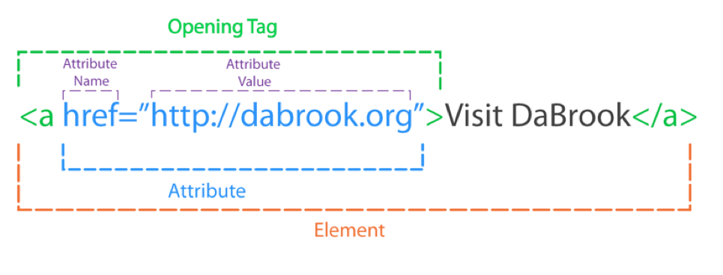
HTML Review

Slide 4
HTML Comments
<!-- This is a comment -->
Comments are for you to read, not the computer
Use comments so you can come back and understand your code later

Slide 5

https://www.youtube.com/watch?v=Z4MGwdKPds8

Slide 6
The Terminal (aka The Command Line)
A faster way of interacting with your computer
Lets you navigate directories, modify files, run programs, and much more!
A few different types – you’re probably using bash

Slide 7
ls - list directory contents
Prints out a list of files in your directory

Slide 8
cd – change directory
Switch to another directory
Usage:
cd ~/Downloads/nycda-iwdd-lesson-2
cd .. (Go up one directory)
cd - (Go to the previous directory)
Notes:
Explain files on your computer are in a tree structure – open up Finder, show this

Slide 9
pwd – print working directory
Print out the name of the directory you’re currently in

Slide 10
rm - remove
Delete a file
Be careful with this one! It deletes forever – files don’t go to your Trash

Slide 11
Command Line Flags
Many commands have options

Slide 12

Git and Github
Git – version control
Github – a site to put your git repos

